Slide 1
WBA CTO Group
Industry Partnerships Status

Slide 2
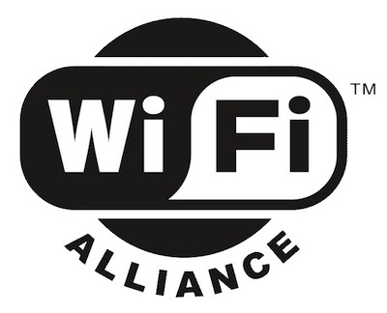
CTOG - WBA Industry Partnerships
Collaboration agreements in place
Active Liaison Relationship
WBA Industry Partnerships Dashboard
Partnerships / Liaison relationships being assessed
The European Conference of Postal and Telecommunications Administrations
Letter of Understanding (LoU) cooperation between the CEPT and WBA
Collaboration with the Global enabling Sustainability Initiative (GeSI)

Slide 3
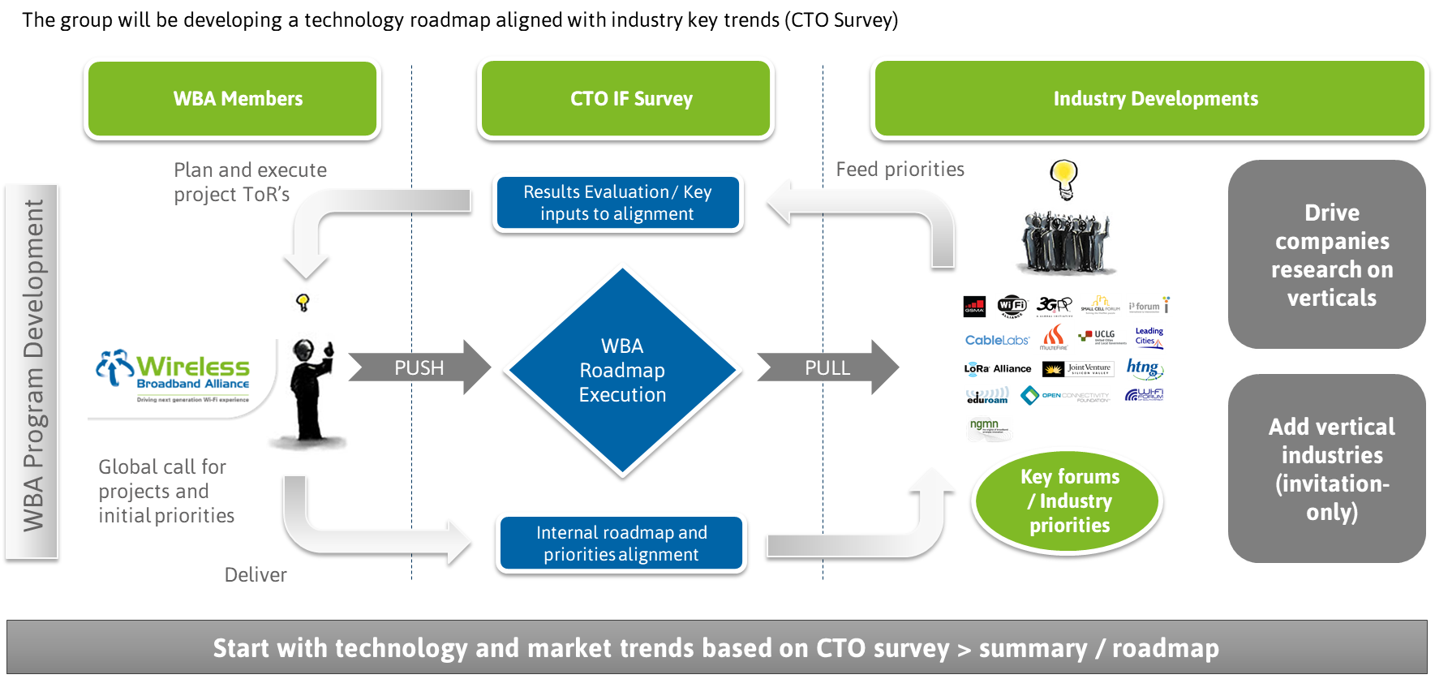
CTOG: WBA Roadmap Development & Alignment with Industry Bodies

Slide 4
Thank You
Thank you
Derek Peterson - CTO Group Chair, Boingo Wireless
Necati Canpolat - CTO Group Co-Chair, Intel Corp.
Matt MacPherson – CTO Group Co-Chair, Cisco
WBA PMO
Bruno Tomas
Pedro Mouta
Engage on projects via WBA extranet | PMO contact: pmo@wballiance.com

